Slide 1

Java Programming
Tetris Game
俄罗斯方块

Slide 2

Tetris(俄罗斯方块游戏)
Tetris is a tile-matching puzzle video game, originally designed and programmed by Russian game designer Alexey Pajitnov.
https://motherboard.vice.com/en_us/article/bmjyq4/the-man-who-made-tetris

Slide 3
Outline
Multi-dimensional array
How to make a Tetris Game*

Slide 4
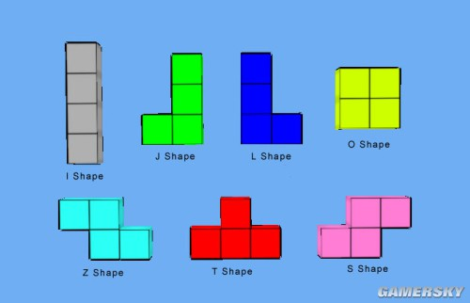
Tetriminos(四格骨牌)
A Tetrimino is a geometric shape composed of four squares, connected orthogonally.
There are 7 kinds of Tetriminos.

Slide 5

How to make a Tetris game?
How to store the Tetriminos?
How to store the map (playing field)?
How to generate a Tetrimino?
How to rotate a Tetrimino?
How to move a Tetrimino?
How to determine whether a rotation or movement is legal?
How to determine whether a row(line) is full?
How to clear a line?
How to score the line clears?
How to end the game?
How to draw the map and Tetriminos?
How to operate the game?

Slide 6

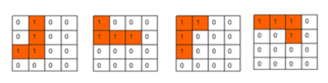
How to store the Tetriminos?
Each Tetrimino has four status, e.g. J shape
We can use 4X4 matrices (2-dimension array) to store them.

Slide 7
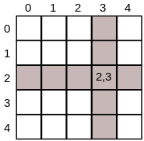
Two-dimensional Array(二维数组)
Two-dimensional arrays are also sometimes called matrices. They work in much the same way as a one-dimensional array but allow you to specify a column index and a row index.
For example, if A is a 2D array of int, then A[2][3] would be the element in row 2, column 3.

Slide 8
Create and initialize 2D Array
Create a 2D array
int[][] A;
A = new int[3][4];
Create and initialize a 2D array
int[][] A = new int[][] {
{ 1, 0, 12, -1 },
{ 7, -3, 2, 5 },
{ -5, -2, 2, -9 }};
int[][] a = { { 1 }, { 3, 4 }, { 5, 6, 7 }, { 9, 10, 11, 12 } };

Slide 9
Conversion between Array & 2D Array
int[][] a ={{0,1,0,0},
{0,1,0,0},
{1,1,0,0},
{0,0,0,0};
int[] b ={0,1,0,0,
0,1,0,0,
1,1,0,0,
0,0,0,0};
a[i][j] == b[i*4+j]
b[i] == a[i/4][i%4]
Notes:
已知矩阵行列，可换算出一维数组下标
已知一维数组下标，也可换算出矩阵行列
也就是说，二维数组可以用一维数组来表示

Slide 10
Multi-dimensional arrays
You can declare a three dimensional array as :
int threeD[][][]= new int [3][4][5];
You can declare a 4 or more dimensional array, but it is not recommended.

Slide 11
Store the J shape Tetrimino
We can use a three-dimensional array to store a Tetrimino
int[][][] J=
{{{0,1,0,0},{0,1,0,0},{1,1,0,0},{0,0,0,0}},
{{1,0,0,0},{1,1,1,0},{0,0,0,0},{0,0,0,0}},
{{1,1,0,0},{1,0,0,0},{1,0,0,0},{0,0,0,0}},
{{1,1,1,0},{0,0,1,0},{0,0,0,0},{0,0,0,0}}};
Notes:
用一个三维矩阵定义一个tetrimino，因为
每个tetrimino共4种状态
每一个状态为一个二维矩阵

Slide 12
Store all the Tetriminos
int shapes[][][] = new int[][][] {
// I shape
{{0,0,0,0,1,1,1,1,0,0,0,0,0,0,0,0},
{0,1,0,0,0,1,0,0,0,1,0,0,0,1,0,0},
{0,0,0,0,1,1,1,1,0,0,0,0,0,0,0,0},
{0,1,0,0,0,1,0,0,0,1,0,0,0,1,0,0}},
// J shape
{{0,1,0,0,0,1,0,0,1,1,0,0,0,0,0,0},
{1,0,0,0,1,1,1,0,0,0,0,0,0,0,0,0},
{1,1,0,0,1,0,0,0,1,0,0,0,0,0,0,0},
{1,1,1,0,0,0,1,0,0,0,0,0,0,0,0,0}};
…
}
Notes:
为了保存所有的tetrimino的所有状态，需要4维矩阵
为了避免4维矩阵，我们将每一个状态用一个一维矩阵表示，而不用之前的二维矩阵

Slide 13
Generate and rotate a Tetrimino
Generate a Tetrimino randomly(随机生成骨牌)
Because shape[i] indicates one of the 7 kinds of Tetriminos.
The index i can be generated from 0 to 6 randomly (with equal probability).
Rotate a Tetrimino(旋转骨牌)
shape[i][j] indicates the jth status of ith shape
Rotate shape[i] means change shape[i] from jth to (j+1)th status

Slide 14
Generate a Tetrimino randomly
class Tetris {
Random ran = new Random();
int TetriminoType;
int rotateState;
int x,y; // position of a Tetrimino on the map
bublic void newTetrimino(){
//shape[TetriminoType] is the new Tetrimino
TetriminoType = ran.nextInt(7);
// shape[TetriminoType][rotateState] is the status of the new Tetrimino
rotateState = ran.nextInt(4);
x=4;
y=1;
}
…
}
Notes:
注意，这些函数去掉了static关键字
而且在函数外部定义了变量！

Slide 15
Rotate a Tetrimino
void rotate() {
int tempState = rotateState ;
rotateState = (rotateState + 1) % 4;
if (collisionDetect(x, y, TetriminoType, rotateState)) {
rotateState = tempState;
}
}

Slide 16
Store the map
We can use two-dimensional array to store the map.
int map[][] = new int[23][13];
The value of each empty square in the map is 0 by default. The value of each square belonging to three sides (left, lower-1, right-1) of the map is 2.

Slide 17
Store the map
0
11
0
2 | 0 | 0 | 0 | 0 | 0 | 0 | 0 | 0 | 0 | 0 | 2 | 0
2 | 0 | 0 | 0 | 0 | 0 | 0 | 0 | 0 | 0 | 0 | 2 | 0
2 | 0 | 0 | 0 | 0 | 0 | 0 | 0 | 0 | 0 | 0 | 2 | 0
2 | 0 | 0 | 0 | 0 | 0 | 0 | 0 | 0 | 0 | 0 | 2 | 0
2 | 0 | 0 | 0 | 0 | 0 | 0 | 0 | 0 | 0 | 0 | 2 | 0
2 | 0 | 0 | 0 | 0 | 0 | 0 | 0 | 0 | 0 | 0 | 2 | 0
2 | 0 | 0 | 0 | 0 | 0 | 0 | 0 | 0 | 0 | 0 | 2 | 0
2 | 0 | 0 | 0 | 0 | 0 | 0 | 0 | 0 | 0 | 0 | 2 | 0
2 | 0 | 0 | 0 | 0 | 0 | 0 | 0 | 0 | 0 | 0 | 2 | 0
2 | 0 | 0 | 0 | 0 | 0 | 0 | 0 | 0 | 0 | 0 | 2 | 0
2 | 0 | 0 | 0 | 0 | 0 | 0 | 0 | 0 | 0 | 0 | 2 | 0
2 | 0 | 0 | 0 | 0 | 0 | 0 | 0 | 0 | 0 | 0 | 2 | 0
2 | 0 | 0 | 0 | 0 | 0 | 0 | 0 | 0 | 0 | 0 | 2 | 0
2 | 0 | 0 | 0 | 0 | 0 | 0 | 0 | 0 | 0 | 0 | 2 | 0
2 | 0 | 0 | 0 | 0 | 0 | 0 | 0 | 0 | 0 | 0 | 2 | 0
2 | 0 | 0 | 0 | 0 | 0 | 0 | 0 | 0 | 0 | 0 | 2 | 0
2 | 0 | 0 | 0 | 0 | 0 | 0 | 0 | 0 | 0 | 0 | 2 | 0
2 | 0 | 0 | 0 | 0 | 0 | 0 | 0 | 0 | 0 | 0 | 2 | 0
2 | 0 | 0 | 0 | 0 | 0 | 0 | 0 | 0 | 0 | 0 | 2 | 0
2 | 0 | 0 | 0 | 0 | 0 | 0 | 0 | 0 | 0 | 0 | 2 | 0
2 | 0 | 0 | 0 | 0 | 0 | 0 | 0 | 0 | 0 | 0 | 2 | 0
2 | 2 | 2 | 2 | 2 | 2 | 2 | 2 | 2 | 2 | 2 | 2 | 0
0 | 0 | 0 | 0 | 0 | 0 | 0 | 0 | 0 | 0 | 0 | 0 | 0
// initialize the map
void newMap() {
for (int i = 0; i < 13; i++) {
for (int j = 0; j < 23; j++) {
map[j][i] = 0;
}
}
// draw walls
for (int i = 0; i < 12; i++)
map[21][i] = 2; //lower-1
for (int j = 0; j < 22; j++) {
map[j][11] = 2; //left
map[j][0] = 2; //right-1
}
}
21
Notes:
下部和有部多余的设计是为了保证碰撞检测和停止算法不会数组越界

Slide 18
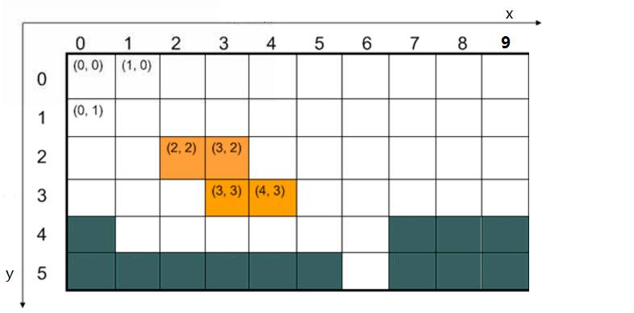
Move a Tetrimino(移动骨牌)
The row and column index (x,y) of the map can be used to indicate the position of (the top-left square) Tetrimino in the map.

Slide 19
Move a Tetrimino
void left() {
if (!collisionDetect(x - 1, y, TetriminoType, rotateState))
x = x - 1;
}
void right() {
if (!collisionDetect(x + 1, y, TetriminoType, rotateState))
x = x + 1;
}
void fall() {
if (!collisionDetect(x, y + 1, TetriminoType, rotateState))
y = y + 1;
}
Notes:
先碰撞检测，再移动
注意，碰撞检测发生在每个动作之前，例如下落时，假定y=y+1，即假设tetrimino已经在y+1的位置上，然后进行检测，如果检测碰撞了，则并不进行真正下落

Slide 20
Is the rotation or movement legal?
Collision detection(碰撞检测)
Check whether the orange squares overlap the dark squares

Slide 21
Collision detection(碰撞检测)
boolean collisionDetect(int x, int y, int blockType, int turnState) {
for (int a = 0; a < 4; a++) {
for (int b = 0; b < 4; b++) {
if (((shapes[blockType][turnState][a * 4 + b] == 1)
&& (map[y + a][x + b + 1] == 1))||
((shapes[blockType][turnState][a * 4 + b] == 1)
&& (map[y + a][x + b + 1] == 2))) {
return true;
}
}
}
return false;
}
Notes:
对Tetrimino的16个方块进行检测，看是否于地图上已经放置的方块重叠

Slide 22
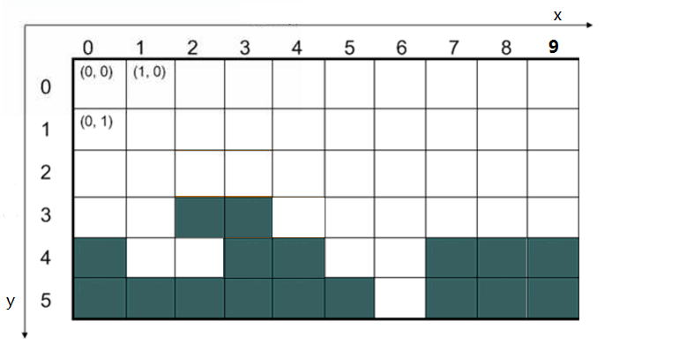
Stop moving(停止移动)
When the Tetrimino can not be moved, the value of squares on the map overlapped by the Tetrimino will be set to be one.

Slide 23
Stop moving
void addToMap(int x, int y, int blockType, int turnState) {
int j = 0;
for (int a = 0; a < 4; a++) {
for (int b = 0; b < 4; b++) {
if (map[y + a][x + b + 1] == 0) {
map[y + a][x + b + 1] =
shapes[blockType][turnState][j];
}
j++;
}
}
}
Notes:
一维数组到二维数组的转换，将Tetrimino的16个方块填到地图对应的位置上

Slide 24
Clear lines(消行)
If the values of the squares in a row are same and equal one, the row is full.
If ith row is full, then the (i-1)th row will fall down to ith, (i-2)th row will fall down to (i-1)th, and so forth.

Slide 25
void clearLines() {
int c = 0;
int lines = 0; // count lines that will be cleared
for (int yy = 0; yy < 22; yy++) {
c = 0;
for (int xx = 1; xx < 11; xx++) {
if (map[yy][xx] == 1) {
c = c + 1;
if (c == 10) {// clear the line
lines++;
for (int cy = yy; cy > 0; cy--) {
for (int e = 1; e < 11; e++) {//falling lines
map[cy][e] = map[cy - 1][e];
}
}
}
}
}
}
}
Notes:
从最上层（第0行）开始，检查每行是否被方块填满（每个格子中，0-无方块，1-有方块）
如果发现yy行满了，则清除这一行，即将yy-1行替换yy行，将yy-2行替换yy-1行，依次类推，一直到第0行

Slide 26
Scores(计分)
score 10 points when clearing 1 line at one time
score 40 points when clearing 2 lines at one time
score 90 points when clearing 3 lines at one time
score 160 points when clearing 4 lines at one time

Slide 27
Game over(游戏结束)
The game ends when the stack of Tetriminos reaches the top of the playing field and no new Tetriminos are able to enter.
That is to say if the new Tetrimino collides the stopped Tetriminos, the game is over.

Slide 28
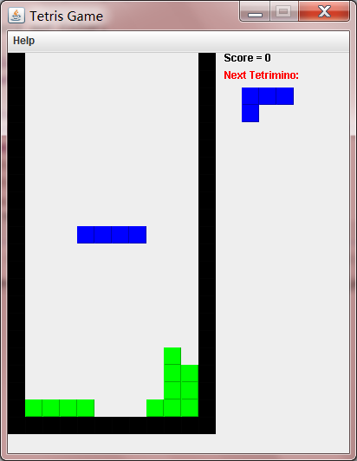
How to make a GUI for Tetris?
We will introduce OO & GUI programming in the future.

Slide 29
Projects/Games
Each team choose one of the following projects.
Blockies
Cube Crash
Maze Game
Two player Tetris (you can refactor the example code)

Slide 30
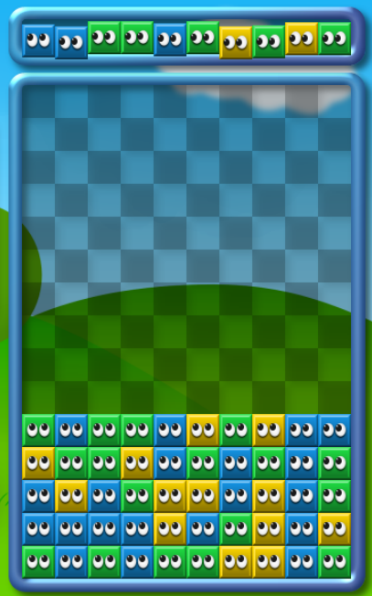
Blockies
The goal of Blockies is fairly simple. You have to remove same-colored blocks by clicking on groups of three or more as they accumulate on the bottom of the screen. As you work to remove blocks, new rows will be falling from the top of the screen.
SEE: http://netpuzzlegames.com/blockies

Slide 31
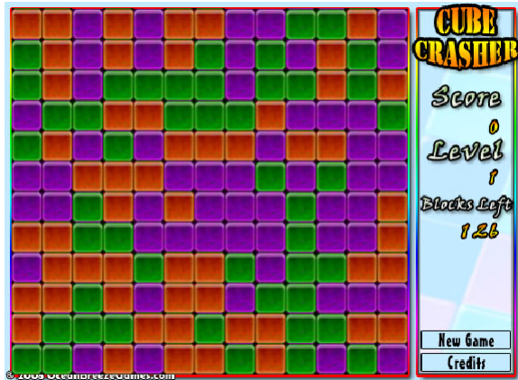
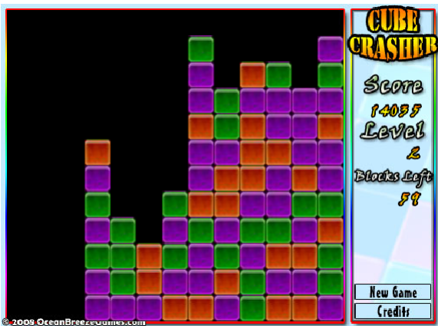
Cube Crash
Click on groups of three or more same colored cubes that are touching on at least one edge. The bigger the group, the more points you get.
As the game progresses more colors are introduced and you are required to remove more cubes to progress to the next level making the game much more difficult.
SEE: http://netpuzzlegames.com/cube-crash

Slide 32
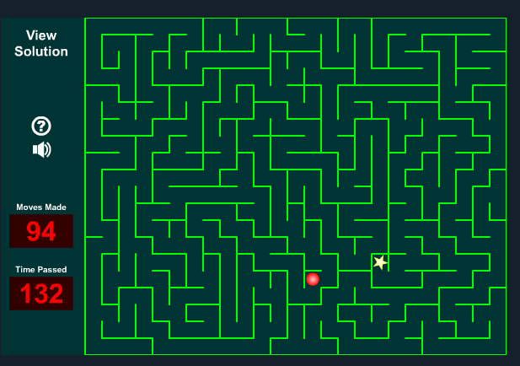
Maze Game
Use the arrow key to move the red ball until you arrive at the yellow star. Win the game as soon as possible. You will lose game if you can not reach the yellow star. Record the user and score in a text file, and you can see the ranking list.
See: http://www.sheppardsoftware.com/braingames/maze/maze.htm

Slide 33


